Slide 1

Selenium WebDriver - Working with Alerts, Frames, and Windows
Session 6.1

Slide 2
Topics
Covered
Handling a simple JavaScript alert box
Handling a confirm and prompt alert box
Identifying and handling frames
Working with IFRAME
Identifying and handling a child window
Identifying and handling a window by its title
Identifying and handling a pop-up window by its content

Slide 3
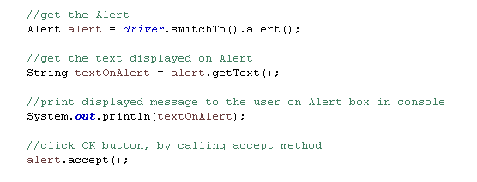
Handling a simple JavaScript
alert box
Alert's are modal windows displayed by browsers where user has to take action before processing further.
The Selenium WebDriver provides an Alert interface for working with JavaScript alerts.

Slide 4



Handling a confirm and prompt
alert box
A confirm box is often used to verify or accept something from the user.
A prompt box is often used to accept a value from a user.

Slide 5
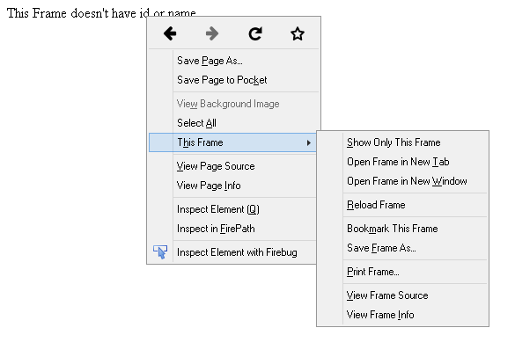
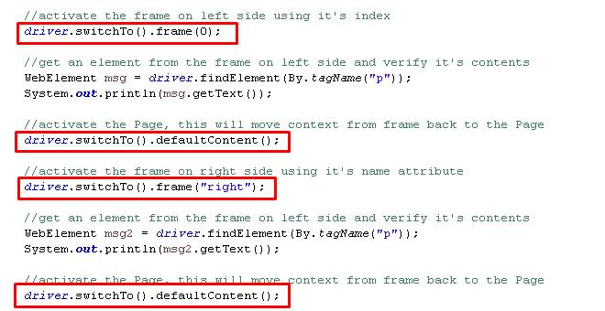
Identifying and
handling frames
A page with frames is created using the <frameset> tag or the <iframe> tag. All frame tags are nested with a <frameset> tag.

Slide 6
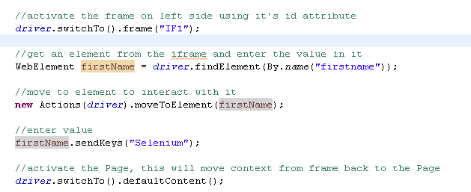
Working with
IFRAME
Developers can also embed external documents or documents from another domain using the <iframe> tag, also known as inline frames.

Slide 7


Identifying and handling
a child window
The Selenium WebDriver allows us to identify a window by its name attribute or window handle, and switching between the window and the browser window is done using the WebDriver.switchTo().window() method.

Slide 8
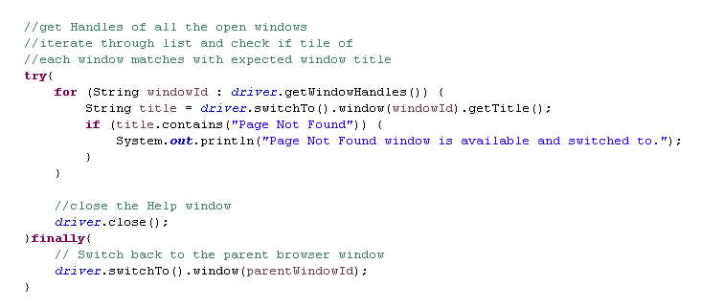
Identifying and handling
a window by its title
Many a time, developers don't assign the name attribute to windows. In such cases, we can use its window handle attribute.
However, the handle attributes keep changing and it becomes difficult to identify the window, especially when there is more than one window open.
Using the handle and title attributes of the page displayed in a window, we can build a more reliable way to identify child windows.

Slide 9
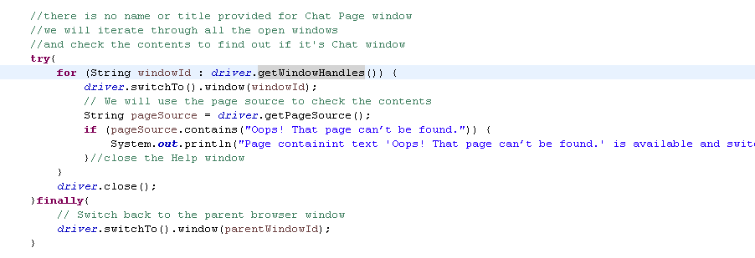
Identifying and handling a pop-up
window by its content
In certain situations, developers neither assign a name attribute nor provide a title to the page displayed in a window.
As a workaround to this problem, we can check the contents of each window returned by the driver.getWindowHandles() method to identify the desired window.

Slide 10


Slide 11
Knowledge Check
What is difference between Explicit Wait and Fluent Wait?
How to handle Alert, Confirm and Prompt box?
What are different ways to switch to Frame?
How to work with multiple Windows?
Difference between getWindowHandle() and getWindowHandles().
What are different ways to switch onto a Window?

Slide 12

Thank you!

